Slide 1
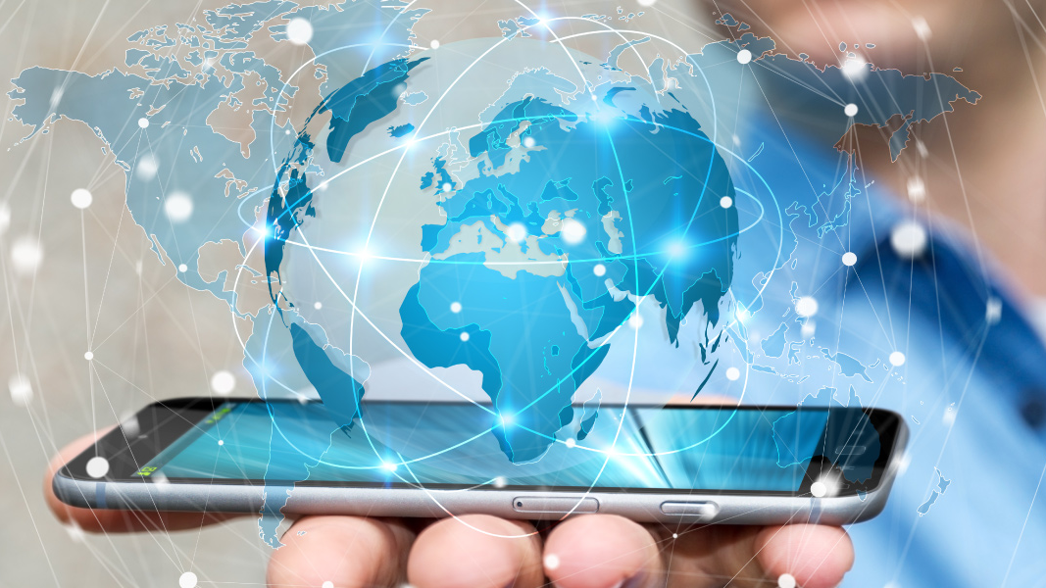
Creative and Innovative Project Title: E-Commerce with Augmented Reality
Team Members:
Akil Vishnu M - 2018115010
Balasubramaniam M - 2018115018
Venkat Karthick P - 2018115125

Slide 2
Introduction:
While the physical world is three-dimensional, most data is displayed on two-dimensional pages, images and screens. This gap is closed by - Augmented reality, a set of technologies that superimposes digital data and images on physical objects and environments.
This concept is taken into account and we thought of providing a new experience in online shopping replacing the traditional experience, where the products are displayed in 2-D images.
The showcasing of products to users is enhanced using Augmented Reality. The products are shown in AR view and 3D view.

Slide 3
Existing works
This project is not available elsewhere.
This project’s idea is inspired from Lenskart Application where an online AR specs trial can be done.
This project incorporates this idea and includes a lot of products rather than only spectacles.

Slide 4

System Design
User Authentication
Retrieve available products
Horizontal Plane Detection
Showcasing products in AR and in 3d
Communicating with Unity3d from Flutter
Vertical Plane Detection
Update User’s Cart upon adding a product to it
Update changes in cart and checkout
Face Tracking

Slide 5
Flow Diagram
User Signup/Login
Products Display
Search/
Category Filters
Selected Product Display
Wearable Products
Non-Wearable Products
AR View
(Face tracking)
3D View of Products
AR View (Horizontal/Vertical Plane Tracking)
Display of
products Added to Cart
Payment
Variant Selection
Checkout

Slide 6
Work Completed: (100% completed)
Unity:
AR display of non-wearable products that reside on horizontal plane has been completed using AR foundation and AR Core horizontal plane tracking.
AR display of wearable products related to face like sunglasses, cap, mask has been completed using AR Foundation and AR Kit face tracking.
Flutter:
Welcome Page, Login, signup page, Home Page, Product page, cart page and success page have been coded in flutter(dart).
3D view of object within the application is created for all the products.
Dynamic background image is generated by selecting the dominant colour in the product’s 2d images and displayed as a gradient.
Integrated with Razorpay with test account.
Design:
Logo has been designed. UI for all the pages have been designed using Figma.
Target marker for the plane detection have been designed that appears on the surrounding to mark the place where the object has to be placed.
3D models in .glb format has been created for all the products created in unity using blender and captured 2D images of all the models.

Slide 7
Integration:
Integration of flutter with unity has been completed and communication with unity from flutter has been completed.
Switching among different scenes in unity using actions from flutter has been achieved.(Each product’s AR design is a separate scene in unity).
Database and backend works:
Database has been designed. User Authentication done using login, signup.
Products are made to display as per category in the home page. Each product has been made dynamically appear with all its respective data in product page. Display of products added to cart has been completed.
Data for all the products made are inserted into firebase firestore.

Slide 8
Demo Video: (video for 75% work)
Github Link:
https://github.com/DIST-projects/cip_2021_bama_ma-am_batch-5010_5018_5125/blob/main/Review1/Demo-video.mp4
Drive Link: https://drive.google.com/file/d/19MOZ0Gb1oFsqMpWPIGrMvnq1RPqzML7p/view?usp=sharing

Slide 9
Complete Demo video:

Slide 10
AKIL VISHNU M – 2018115018
Design:
Designed the logo for the application.
Designed all the UI using Figma.
Designed target for the AR placement of objects.
Flutter:
Implemented Front end pages – Product page, Action sheet in checkout, Cart page, Payment success page.
Created splash screen.
Done UI fixes in all other pages of flutter.
Implemented 3D view of objects and generated glb objects.
Created a “smartphone” 3d object in Blender.
Obtained 2d images of all 3d products using blender.
Integration:
Flutter – Unity Integration done using flutter_unity_widget plugin for AR scenes.
Switching between different unity scenes done.
BALASUBRAMANIAM M – 2018115018
Flutter:
Implemented Front end pages – Welcome page, Login and Signup Page, Home page, AR display page.
Created Search and category filters in products.
Done UI fixes in all other pages of flutter.
Integrated with razorpay with test account.
Database:
Designed the database.
Integrated flutter and firebase.
Firebase Authentication done.
Contents of the pages in flutter obtained from firebase, insertions, updations and deletions done.
Integration:
Integrated a simple unity scene with flutter.
Flutter – Unity Integration done using flutter_unity_widget plugin for AR scenes. Communication between Flutter and Unity done.
Switching between different unity scenes done.
Added some products under horizontal plane detection.
VENKAT KARTHICK P – 2018115125
Database:
Designed the database.
Obtained data for the products.
Unity:
Tried AR with Vuforia.
Sample horizontal plane detection done using a spider model using AR Foundation and AR Core.
AR placement c# script added to place object on the detected plane.
Sample face tracking done, which paints the detected face with a material using AR Kit face tracking.
Created more plane detection scenes with unwearable objects – Sofa, Laptop, Drum set.
Created more face tracking scenes with wearable objects – sunglasses, power glasses, cap, mask.
Created 2d Loading scene.
Added more products in all category.
Integration:
Flutter – Unity Integration done using flutter_unity_widget plugin for AR scenes.
Switching between different unity scenes done.

Slide 11
Innovation:
Replacing the traditional experience of online shopping.
Enhancing the traditional showcasing of products with Augmented Reality which provides users more satisfaction on buying a product.
Creativity:
Dynamic page background has been implemented.
Provided an png image, its dominant colour is found and made as the background. This provides a different view experience for each and every products that the user view in our application.
Flutter-Unity integration has been done and switching scenes done using a gameObject.

Slide 12
Satisfaction with the work:
Yes, we are satisfied with the work that have been completed so far.
Whatever was aimed to be done during the start of the project have been established.
Implemented many other extra creative elements relevant to the idea of the project.

Slide 13
Self Evaluation:
25/25
Reason:
All ideas discussed during idea explanation in the class have been achieved, no compromise have been made.
Weekly target set by us have been achieved all the week and pushed daily completed work to github.
Added a ‘progress.md’ file in github which states our progress in the project.
Also added more creative aspects to the application relevant to the idea of the project.

